Slide 1
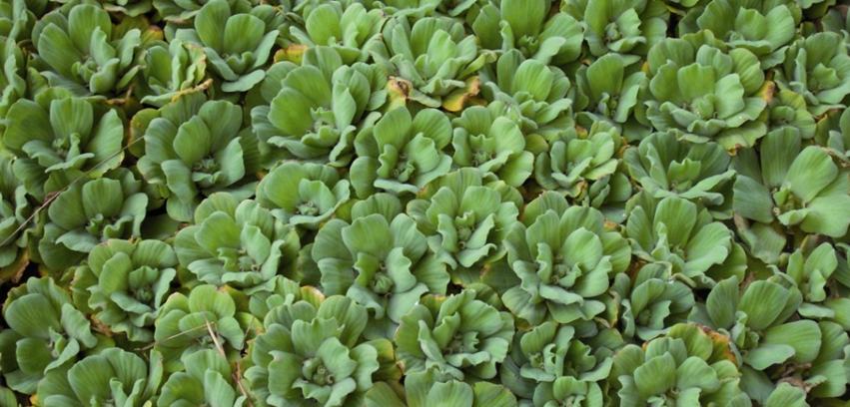
Seen this plant?
Water lettuce
Pistia stratiotes
How does this weed affect us?
Water lettuce is a free floating aquatic plant with the potential to quickly spread and form a dense mat that can cover an entire body of water.
It causes:
poor water quality
less food and habitat for fish and other water life
blocked irrigation equipment
problems for boating, fishing and water activities
more habitat for mosquitos.
Your local weeds officer
NSW DPI Biosecurity Helpline:
Seen it? Call us:
xxxxxxxx
1800 680 244
Help protect our land, plants and wildlife.
For control and biosecurity information visit NSW WeedWise: weeds.dpi.nsw.gov.au/Weeds/waterlettuce

Slide 2
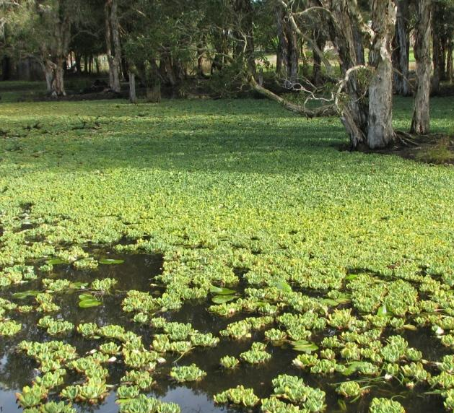
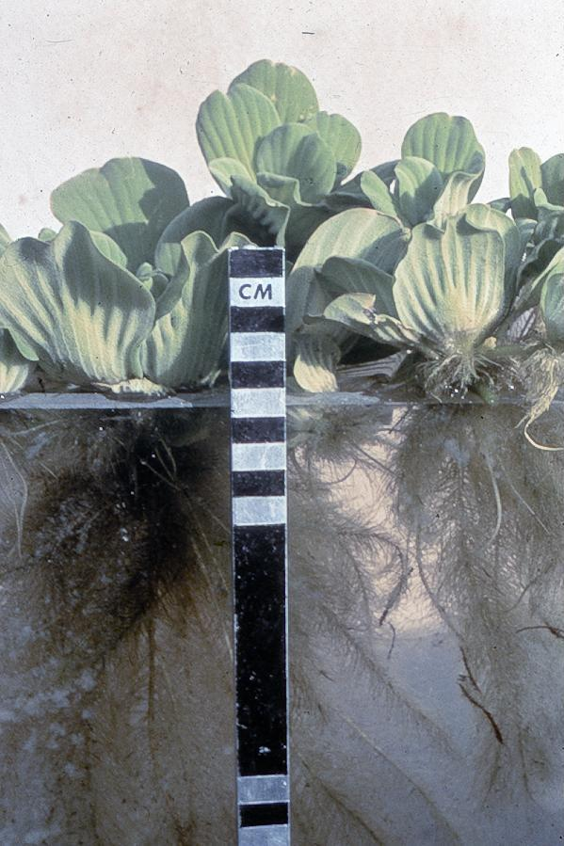
Where are you likely to find it?
Water lettuce grows best on still or slow moving bodies of fresh water such as farm dams, reservoirs, lakes, rivers and creeks. Water lettuce can survive for long periods on muddy banks or in other damp locations such as roadside culverts.
What does it look like?
Water lettuce looks like an open head of lettuce floating on the water. Its roots hang in the water and do not attach to the bottom. Plants are up to 15 cm high and 30 cm wide. Plants produce daughter plants that remain attached to the parent plant by white root-like stolons. These can be 60 cm long.
Your local weeds officer
NSW DPI Biosecurity Helpline:
Seen it? Call us:
xxxxxxxx
1800 680 244
Help protect our land, plants and wildlife.
For control and biosecurity information visit NSW WeedWise: weeds.dpi.nsw.gov.au/Weeds/waterlettuce

