Slide 1
2024 Fairfield ClubGRANTS Information Session
Hosted by Fairfield City Council

Slide 2
Fairfield ClubGRANTS Information Session 2024
Welcome & Housekeeping
Please ensure your mobile phones are on silent
Introduce yourself and the organisation you are from
Please keep your questions to the end as we will have time to answer any questions at the end of the session
We will send all participants a copy of the PowerPoint after the workshop

Slide 3
Acknowledgment of Country
We would like to Acknowledge the Cabrogal of the Darug Nation who are the Traditional Custodians of this Land we are meeting on today. We also pay our respect to the Elders both past and present and future of the Darug Nation.

Slide 4
What is ClubGRANTS?
ClubGRANTS is one of Australia’s largest grant programs, providing more than $100 million in cash each year to a variety of worthy causes across NSW
ClubGRANTS is designed to ensure that larger registered clubs in NSW contribute to the provision of front-line services to their local communities
The ClubGRANTS program requires local clubs earning in excess of $1 million in gaming machine profit to invest 1.85% of their profits back into the community
Local not-for-profit organisations have the opportunity to apply for funding
The program only funds Community Development projects that will benefit local Fairfield residents
Notes:
Projects must be specifically targeted at meeting the needs of Fairfield residents
Can be located outside of the Fairfield LGA however must benefit and service the Fairfield Area

Slide 5
ClubGRANTS Guidelines – September 2023
Notes:
Keep up to date with ClubGRANTS guidelines – they were last updated in September 2023 but are generally updated every year or two. Read the guidelines carefully.

Slide 6
11 Participating Clubs
Notes:
11 participating clubs:
Club Marconi
Triglav Mounties Group – St John’s Park
Cabramatta Rugby Leagues Club
St John’s Park Bowling Club
Canley Heights RSL
Fairfield RSL
Mekong Mounties Group – Cabramatta
Mounties - Mount Pritchard
Cabra-Vale Diggers
Smithfield RSL
Cabramatta Bowls

Slide 7
2024 Round Dates
Opening
Friday 1 February 2024
Closing
Friday 31 May 2024
Notes:
Applications close at 5pm on Friday 31 May 2024
New guidelines and change of applications dates as per September 2023 guidelines

Slide 8
2023 Category 1
Total amount funded
95 projects
$1,572.470
To view 2023 funded projects visit:
2023 Funded Projects
Notes:
Can find category 1 and 2 grants???

Slide 9
ClubGRANTS Categories
Category 1
Eligible Category 1 expenditure is for projects and/or services that contribute to the welfare and broader social fabric of the local community and are aimed at improving the living standards of low income and disadvantaged people.
Funding will be granted for:
Specific community welfare and social services
Community development projects, activities or events
Health services and employment assistance activities
Notes:
Council administers Category 1 funds ONLY

Slide 10
What kind of Cat 1 projects are funded through ClubGRANTS?
Youth Projects
Support programs for young people
Group Training
Employment Programs
Disability programs
Artistic Projects
Innovative Community Projects
Community Events
Education programs for CALD Communities
Projects for older people
Community workshops
Social
Enterprise
Notes:
I’ll run through some examples of projects previously funded last year towards the end of the session to give you an idea of the types and variety of projects funded
Community Outcome

Slide 11
ClubGRANTS Priority Areas
Community Welfare and Social Services
Community Development
Community Health Services
Employment Assistance Activities
Notes:
These are the ClubGRANTs Priority Areas listed in the ClubGRANTs Guidelines

Slide 12
ClubGRANTS Priority Areas
Community Health Services
Early childhood health
Child and family services
Community nursing
Therapy, including art therapy
Community mental health services
Health promotion initiatives
Drug and alcohol services
Palliative care/women's health/dental/ disability services
Aboriginal and Torres Strait Islander health services
Home and community care services
Notes:
Funding for medical research is not eligible as Category 1 expenditure.

Slide 13
ClubGRANTS Priority Areas
Community Development
Neighbourhood centre activities
Community education programs
Youth drop-in facilities
Community transport services
Tenants' services
State-wide or regional services developing social policies and providing advocacy for local community services

Slide 14
ClubGRANTS Priority Areas
Employment Assistance Activities
Employment placement services
Group training
Employment advocacy
Community enterprises
Local job creation schemes

Slide 15
ClubGRANTS Priority Areas
Community Welfare and Social Services
Family Support
Supported emergency or low cost accommodation
Counselling services
Domestic Violence services
Child Care and Child protection
Aged, Disability or youth services
Veteran welfare services
Services to victims of natural disasters
Volunteer emergency services, such as surf life-saving and rural fire services

Slide 16
ClubGRANTS Categories
Category 2
Funding for community development and support activities not listed under category 1 as well as expenditure allocation to a clubs’ core activities
For example sport, returned servicemen's league or veteran welfare, golf courses and bowling greens etc. This also includes wages paid to staff to carry out maintenance
Category 2 will also fund Community/Cultural events and projects that include only the cost of capital equipment
Please note that Council does not administer Category 2 applications, these applications are made directly to the relevant Club and will require Club Board approval.
Notes:
Category 2 funding includes breakfast clubs and projects that include only the cost of equipment (no community development focus)
Speak to your local club!

Slide 17
Where to find Category 1 & 2 grants?
https://www.clubgrants.com.au/find-your-local-grant-round
Notes:
Can find category 1 and 2 grants.

Slide 18
ClubGRANTS Categories
Category 3
A state-wide funding pool that supports the construction of large-scale community infrastructure projects or services with sport, health or community infrastructure
Category 3 projects and services funded by ClubGRANTS cannot be funded under Category 1 or Category 2
Liquor and Gaming NSW is responsible for operational management of the Fund, contract management of funded projects, acquittals and reporting
Clubgrants Category 3 Fund | NSW Government
Notes:
The Minister approves the eligibility, criteria and application dates for grant rounds under ClubGRANTS Category 3.
Open twice a year

Slide 19
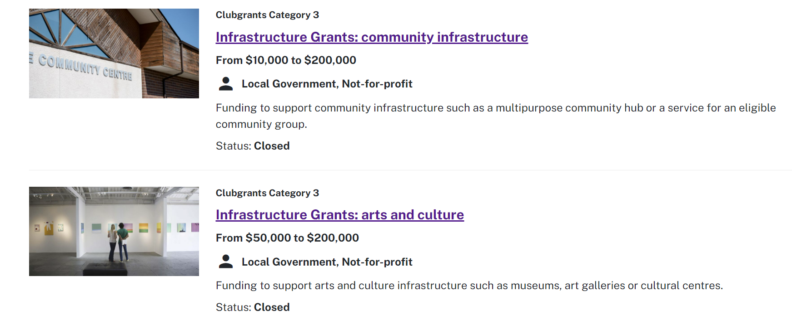
ClubGRANTS Categories
Category 3
Notes:
Category 3 grants are administered by Liquor and Gaming
The Minister approves the eligibility, criteria and application dates for grant rounds under ClubGRANTS Category 3.
Open twice a year

Slide 20
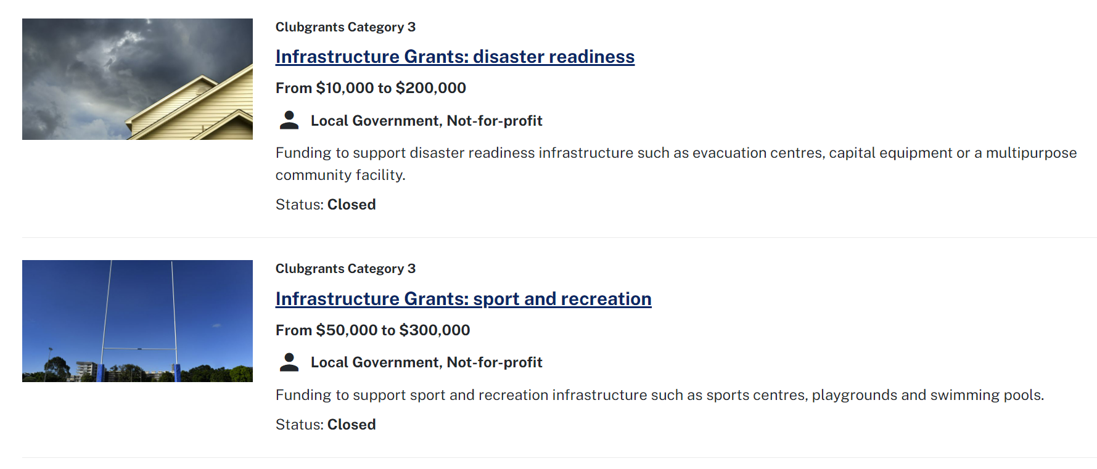
ClubGRANTS Categories
Category 3

Slide 21
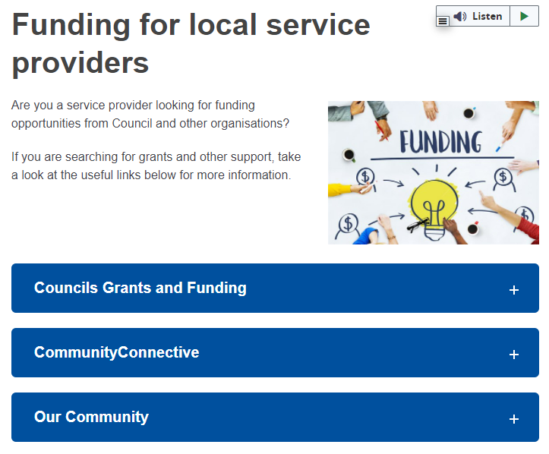
Where to find grants?
Funding for local service providers Fairfield City Council (nsw.gov.au)
Notes:
There are a range of other grant opportunities available throughout the year. Council has a list of Council grants and funding available on our website if you click the link above.

Slide 22
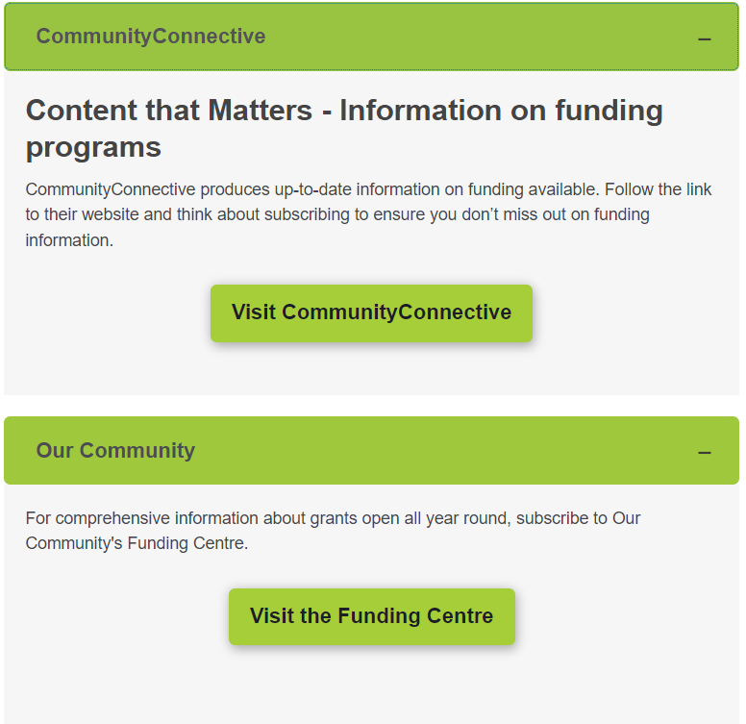
Funding for local service providers Fairfield City Council (nsw.gov.au)
Notes:
These two e-newsletters provide up-to-date information on funding information and opportunities! I would encourage you to subscribe to keep up to date with the latest grants information

Slide 23
Eligibility Criteria
Eligibility Criteria | ✓
Projects must be community development focused
Projects must target the Fairfield local community
Projects must address at least one of the Fairfield City Council local community priorities
Organisations must be incorporated or registered with ACNC. Projects can be auspiced by another registered organisation e.g. these may be referred to as not for profit organisations, non-government organisations and charities
Notes:
This is the eligibility criteria FCC uses to assess the eligibility of the Clubs. This is then reviewed with the Local Committee who makes the final decisions on what applications fit in Category 1 and 2.

Slide 24
Eligibility Criteria
Eligibility Criteria | ✓
Projects must NOT be a duplication of another project or be the core business/duties of the organisation/stakeholder
As a general rule, it is important that funding preference is not given to projects or services that can be readily assisted by an existing Government funding program
Recipients of ClubGRANTS must have submitted their acquittals
Notes:
Each local committee has a different eligibility criteria –
Recipients of ClubGRANTS must have submitted their acquittals
Must be submitted progress and/ppr acquittal must contact us
Clubs determine extension, council do not make this decision

Slide 25
Fairfield ClubGRANTS Local Committee – Eligibility Requirements
Eligibility Criteria | ✓
Projects must NOT include the cost of motor vehicles (e.g. vans used to transport clients which incur ongoing maintenance costs)
Projects that include only the cost of capital items (e.g. sporting equipment and events, project equipment, Ipads, prams etc.) Without a community focused outcome will be referred to Category 2
Projects must NOT be community infrastructure projects (e.g. modifications to group homes, kitchen renovations etc.) (refer to Category 3)
Notes:
Recipients of ClubGRANTS must have submitted their acquittals

Slide 26
Fairfield ClubGRANTS Local Committee – Eligibility Budget Considerations
The committee will fund:
Projects that include costs for salaries and wages (up to 80% of the total project cost). In previous years salaries and wages were not funded
Projects that include costs for administration (up to 10% of the total project cost)
Notes:
Each committee (different LGAs) will have different eligibility areas

Slide 27
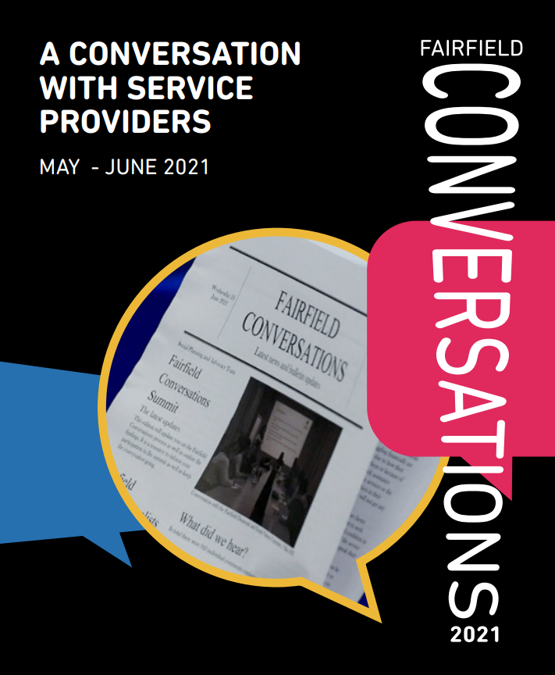
2023-24 Fairfield Local Community Priorities
Access and Inclusion
Alcohol and Other Drugs
Community Safety and Crime Prevention
Community Wellbeing
Cultural Diversity
Domestic and Family Violence (DFV)
Education and Employment
Housing and Homelessness
Financial stress and social isolation
Gambling
Health
Mental Health
Aged
Disability
Youth
Fairfield Conversations Fairfield City Council (nsw.gov.au)
Notes:
Specific local priority areas identified through the 2021 and 2023 Fairfield Conversations. Fairfield Conversations is a social planning and engagement activity with local community service providers that aims to identify current and emerging social needs from the perspective of support services and professionals.

Slide 28
The Process
ClubGRANTS round is announced on Council’s website, plus email notice to past applicants
Applications are accepted online until 5pm on the closing date
Applications are assessed for eligibility by The Grants Team
Applications are collated and ranked by the ClubGRANTS Assessment Committee
Ranked projects are forwarded to the participating clubs for funding nomination
Clubs allocate funds to the projects they have chosen to fund during the Project Selection meeting
Successful applicants are informed via email and invited to the ClubGRANTS Ceremony where they will officially meet the funding club
Unsuccessful applicants are notified via email and encouraged to apply again the following year
Funds are transferred and the round is finalised
Notes:
Application are acknowledged by ClubNSW and additional information is sought if required.
Applications are collated and ranked by the ClubGRANTS assessment subcommittee.
Ranking is added to the database and sent to the participating clubs for decision.
Clubs allocate funds to the projects they have chosen to fund at Board Meeting
Successful applicant are informed via mail/email and invited to the ClubGRANTS Presentation Ceremony in early August where they will officially meet the funding club representatives.
Unsuccessful applicants are notified via mail in early August and encouraged to apply again the following year.
Funds are transferred and the round is finalised..

Slide 29
Processes once application has been received
February, March, April and May
Applications are open
June
Applications are ranked:
- High
- Medium
- Low
- Ineligible or to be referred to Cat 2
June
Applications are checked by The Grants Team to ascertain applicants meet all the funding eligibility guidelines and criteria
Notes:
Applications are received and collated
Each application is assessed by the Assessment subcommittee
Assessment is based on eligibility and meeting the community needs as stated on the City Plan
Application are then ranked
High
Medium
Low
Ineligible
Possible Cat 2
Scores are entered into the database and the database is sent to participating Club board of directors

Slide 30
Project Allocation & Outcomes
August
Successful recipients will receive an email from the funding Club notifying of outcome and requirements. If project is over $10,000, applicant will need to return the Letter of Offer (PDF form) to Club. Council to notify unsuccessful applicants.
July
Clubs representatives meet to select projects of their choice for funding
Notes:
Previous years, Council sent through an email with the funding agreement or letter of offer. Last year all applicants were notified via the ClubGRANTS system online – emails were sent online. This process will continue this year.

Slide 31
Project Allocation & Outcomes
September
Presentation Ceremony
Notes:
Previous years, Council sent through an email with the funding agreement or letter of offer. Last year all applicants were notified via the ClubGRANTS system online – emails were sent online. This process will continue this year.

Slide 32
How to apply?
www.fairfieldcity.nsw.gov.au
Grants & Funding
ClubGRANTS
Community
https://www.fairfieldcity.nsw.gov.au/Community/Grants-and-Funding#section-4
Notes:
Go to webpage. Follow the link.

Slide 33
ClubGRANTS Online Submission website:
https://www.clubgrants.com.au/

Slide 34
Application Requirements
Applications must be submitted by 5pm on the closing date. Applications submitted after this time and date will not be considered
All mandatory supporting documents must be attached to the application. If you have trouble attaching documents, please contact ClubASSIST on 1300 730 001
The ClubGRANTS Local Committee will not consider further applications until they have received a final project report or progress report on previously funded projects
Once you have lodged your completed 2024 online application, you will receive an acknowledgement email. If you do not receive this email, please contact ClubASSIST on 1300 730 001

Slide 35
ClubsNSW Information
https://www.clubgrants.com.au/how-to-apply
https://www.clubgrants.com.au/faqs
https://www.fairfieldcity.nsw.gov.au/Community/Grants-and-Funding#section-4
https://www.clubgrants.com.au/help/applicants
Click here
Notes:
Click on the help button at the top right hand side of the page – then click on help for applicants

Slide 36
ClubsNSW Information
Click here
Notes:
Then click on help for applicants

Slide 37
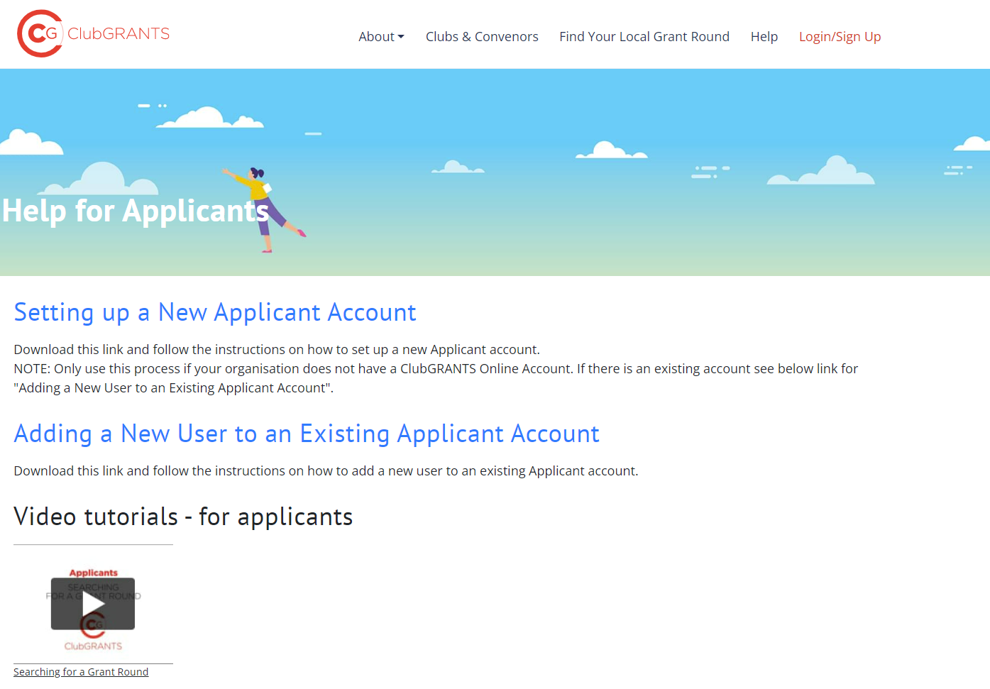
ClubsNSW Information
Notes:
There are now video tutorials available for applicants to help guide you through the system. Another new feature is how to add a new user to an existing applicant account – this is a common problem we have seen before with staff turnover. Please try where possible to have a generic grants email address to ensure messages are being delivered to the right person and progress/acquittal reports are being completed.

Slide 38
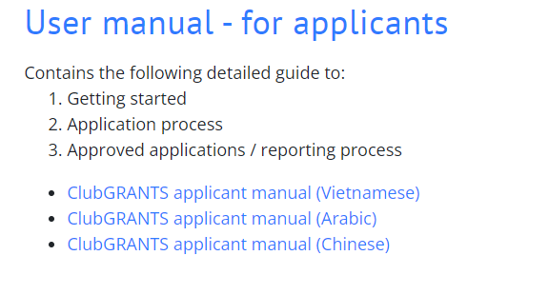
ClubsNSW Information
Applicant Manuals available in English, Vietnamese, Chinese and Arabic.
https://www.clubgrants.com.au/faqs
Notes:
There are a range of applicant manuals (hard copy versions are available at the front). Applicant manuals are available in English, Vietnamese, Chinese and Arabic

Slide 39
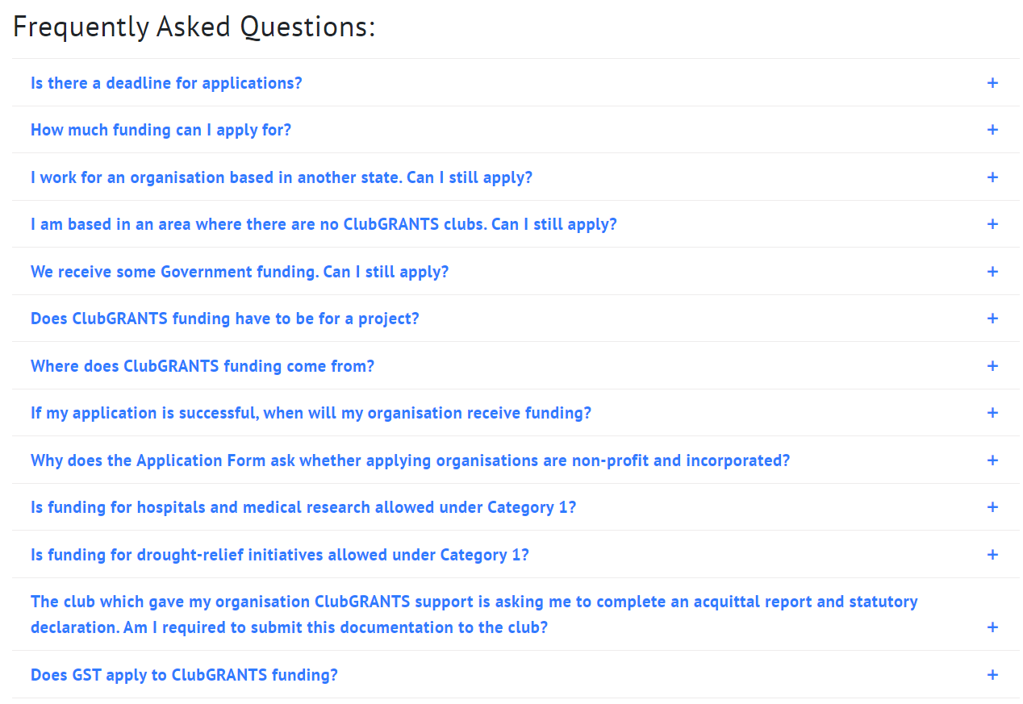
ClubsNSW Information
Notes:
The Help page also has a list of frequently asked questions

Slide 40
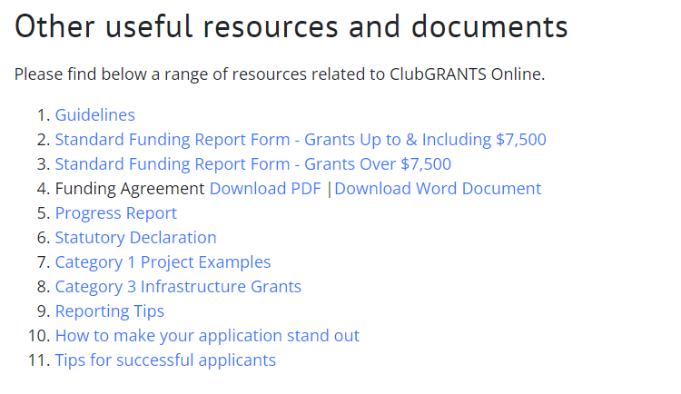
ClubsNSW Information
Notes:
The resources are also available on the help page.

Slide 41
Contact Details – Technical/Application Enquiries
ClubAssist
Tel: 1300 730 001
https://www.clubgrants.com.au/faqs
Notes:
For all technical enquiries relating to the ClubGRANTS Online website (e.g. application submissions, technical/system issues), please contact ClubsNSW MEC on 1300 730 001.

Slide 42
Contact Details – Project Enquiries
The Grants Team
Cherie Pescod
Community Projects & Partnerships Officer
Tel: 9725 0760
Email: clubgrants@fairfieldcity.nsw.gov.au
Edwina Yang
Business Support Officer
Tel: 9725 0222
Email: clubgrants@fairfieldcity.nsw.gov.au
Notes:
For any enquiries relating to your project (e.g. project ideas, eligibility criteria), please contact The Grants Team on 9725 0222 or clubgrants@fairfieldcity.nsw.gov.au.

Slide 43
Contact Details – Funding Enquiries
For any questions around extension of progress reports, acquittal reports or changes to funding agreements – please contact the Funding Club.
Participating clubs in the Fairfield LGA
Fairfield RSL Club
Cabra-Vale Diggers Club
Mounties
Mekong Mounties Group
Triglav Mounties Group
St Johns Park Bowling Club
Canley Heights RSL
Club Marconi
Cabramatta Rugby Leagues Club
Smithfield RSL
Cabramatta Bowling Club

Slide 44
Grant Writing Tips! How to correctly complete an application, budget and workplan?

Slide 45
Funding Budget
Be reasonable with amount requested
Provide a detailed budget – show all workings e.g. 10 x 2hr sessions @ $80.00 per session)
Itemise all expenditures with clarity
Income = expenditures
Outline in-kind contributions
Part-funding option if elected
Make sure your numbers add up correctly
Notes:
Part funding options – e.g. 30k from Mounties, 20k from Cabravale, or streamline funding
Answer question – about part funding – yes or no

Slide 46
Budget (Poor Sample)
Income Description | Amount | Expenditure Description | Amount
Fairfield ClubGRANTS | $15,750.00 | Training | $3,200.00
 |  | Venue Hire | $400.00
 |  | Refreshments for Training Workshops | $600.00
 |  | Design and print flyers and posters for promotion of activities | $300.00
 |  | Administration | $1,250.00
 |  | Salary for Coordinator | $10,000.00
Total | $15,750.00 |  | $15,750.00
Notes:
The budget should be clear – detail the expenses as much as possible
This is quite vague and difficult for the assessors to understand exactly what the money will be spent on and whether it is value for money

Slide 47
Budget (Good Sample)
Income Description | Amount | Expenditure Description | Amount
Fairfield ClubGRANTS | $15,750.00 | Training for 15 participants delivered by TAFE Trainers @$320 per session x 10 sessions | $3,200.00
 |  | Venue Hire – Community Centre @$10/hour x 40 hours | $400.00
 |  | Refreshments for Training Workshops @ $5 x 30 participants x 4 sessions | $600.00
 |  | Design and print 1000 flyers and 50 posters for promotion of activities | $300.00
 |  | Administration (phone calls, printing, stationery) | $1,250.00
 |  | Project Coordination/Facilitation Fees @ $25/hr x 4 hrs per day x 5 days per week x 20 weeks | $10,000.00
Total | $15,750.00 |  | $15,750.00
Notes:
Additional

Slide 48
Project Workplan
Outline Objective(s)
Tasks and actions:
What are the activities you need to do to implement your project?
Performance indicators:
How will you measure the success of the tasks and actions?
Timeframes:
When will it be done by?
Notes:
Workplans are required

Slide 49
Workplan (Poor Sample)
Q 6. Work Plan. Please complete the following project work plan,
for only up to 3 objectives.
Objective 1: Increase participants confidence in job readiness with the completion of the
Hospitality and Customer Service Certificate.
Q 7. Objective 1 details:
Tasks-Actions | Performance Indicator | Timeframe
Promote event | Send email notice to service providers | June 2024
Recruit trainer | Put job ads in the paper | Feb 2024
Recruit participants | Participants recruited | Sept 2024
Deliver training course | Participants trained | July 2025

Slide 50
Workplan (Good Sample)
Q 6. Work Plan. Please complete the following project work plan,
for only up to 3 objectives.
Objective 1: Increase participants confidence in job readiness with the completion of the
Hospitality and Customer Service Certificate.
Q 7. Objective 1 details:
Tasks-Actions | Performance Indicator | Timeframe
Promotional flyer developed, designed, printed and distributed to service | 30 service providers contacted and promoted events. 40 referrals received | August 2023
Conduct 2 information sessions to promote project to recruit suitable candidates | 40 participants attended and 20 submitted their expression of interests | September 2023
Interview and assess all suitable applicants for the 15 vacancies | 15 suitable candidates recruited | October 2023
Organise the training courses | 15 candidates attended and completed the Hospitality and Customer Service certificate course | May 2024

Slide 51
Funding Tips
Targeting the identified local priorities (Fairfield Conversations)
Demonstrate how your project will benefit/impact the local community and number of people benefited or impacted
Use relevant statistics and data to substantiate your claims or issues
Value for money
Be creative and innovative with your project
Use plain English
Specify the who, what, when, where and why
Establish a relationship with your local clubs
Have a co-worker read your application prior to submitting it
https://www.clubgrants.com.au/themes/custom/clubgrants_bs4/files/cg_resource_standout.pdf
Notes:
The more a club knows about your organisation and the type of work you do, the more likely you are to receive funding. Likewise, the more you know about a club, the better you can tailor your application to meet their values and interestsc

Slide 52
Feedback on previous submissions
Applicants had submitted unrealistic budgets – project did not represent value for money
Too much money spent on administration and too little on service delivery
Too much money spent on equipment items with minimal service provisions
Project workplan objectives are unclear or unrealistic – the project lacks clarity and detail
Project submitted for the wrong category, they put in for Cat 1 but their project was a Cat 2 - e.g. capital items or sporting projects – read the guidelines clearly
Notes:
Example of feedback – reasons they were not funded

Slide 53
Useful Websites - Statistics
Community Profile – Demographic Resources
https://profile.id.com.au/fairfield
http://www.fairfieldcity.nsw.gov.au/info/20005/community_services/971/community_profile
Crime data for each LGA in NSW: https://www.bocsar.nsw.gov.au/
Centrelink data (numbers of people on different payments, job seeker numbers, unemployment figures): https://lmip.gov.au/
Health data collated from a range of sources for each LGA across Australia: https://phidu.torrens.edu.au/social-health-atlases
HealthStats NSW is a 'one-stop-shop' providing statistical information about the health of the NSW population
https://www.health.nsw.gov.au/hsnsw/Pages/default.aspx
Unemployment rates for every LGA in Australia, each state and the national rate (quarterly): https://www.dese.gov.au/employment/employment-research
NSW Population projections to 2036 for each LGA in NSW https://www.planning.nsw.gov.au/Research-and-Demography/Population-projections
Notes:
Outline statistics – to highlight evidence of need

Slide 54
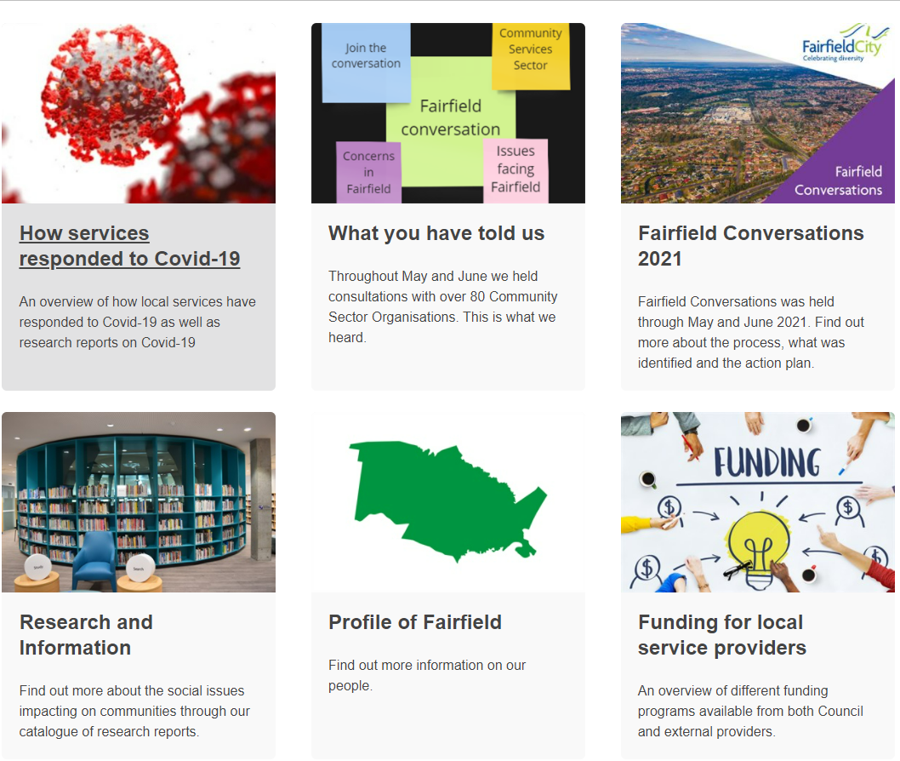
Useful Websites - Statistics
Fairfield Conversations
https://www.fairfieldcity.nsw.gov.au/Community/Fairfield-Conversations/Research-and-Information
Notes:
Fairfield Conversations is a social planning and engagement activity with local community service providers that aimed to identify current and emerging social needs from the perspective of support services and professionals.

Slide 55
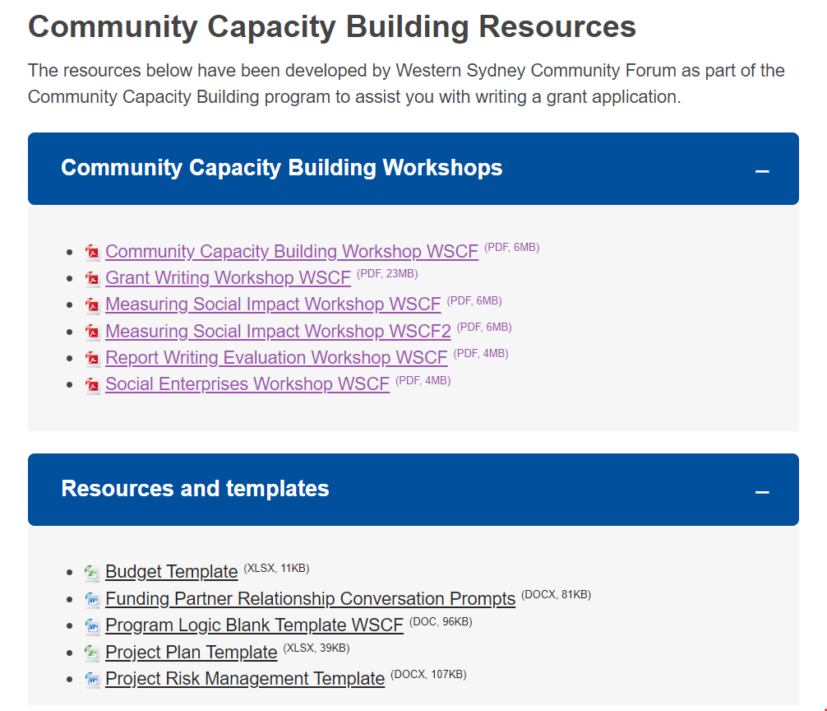
https://www.fairfieldcity.nsw.gov.au/Community/Grants-and-Funding#section-6

Slide 56
Grant Writing Workshops
This grant writing workshop is intended to give local service providers insight into how to write a good grants application. The workshops will be facilitated by Keith Whelan from The Grants Guy.
Dates:
Thursday 22 February | 9.30am – 11.30am (in person)
Thursday 22 February | 5.30pm - 7.30pm (in person)
To register: https://grantwritingworkshops2024.eventbrite.com.au

Slide 57
Community Grants Information Sessions
This session will provide information about Council’s Community Development Grants program. Hear from the Grants Team on the updated guidelines, past successful projects and priority areas. There will also be opportunity for a Q & A!
Dates:
Wednesday 21 February | 9.30am – 11.30am (in person)
Wednesday 21 February | 5.30pm - 7.30pm (in person)
To register:
https://Communitygrantinfosession2024.eventbrite.com.au

Slide 58
Grant Writing Workshops
What will be covered:
What Grants Funding is there and How to Apply for them?
Grants Project Plan
Grants Budget
Grant Writing Do’s & Don’ts
Practical Writing Tips
Creating Grants Templates for Standard Application Questions
Creating a Grants Calendar
Grants Acquittal, Auditing & Evaluation
Writing a Business Case
Report Writing, Funding Acquittals & Evaluation
Establishing Community Capacity Building

Slide 60
Thank you for attending! ☺
Please fill in the survey – your feedback will assist us with planning of future workshops.

